Slide 1
Magnetically Coupled Circuits
Notes:
Asas

Slide 2
Disciplines applying EM EM devices
Words learning
electric machines,
electromechanical energy conversion,
radar meteorology,
remote sensing,
satellite communications,
bioelectromagnetics,
electromagnetic interference and compatibility,
plasmas,
ﬁber optics
electric motors and generators,
transformers,
autotransformers,
electromagnets,
magnetic levitation,
antennas,
radars,
microwave ovens,
microwave dishes,
Superconductors
electrocardiograms.

Slide 3
Outline
Mutual Inductance
Analysis of Circuits with Mutual Inductance
The Transformer

Slide 4
Mutual Inductance
Notes:
Asas

Slide 5
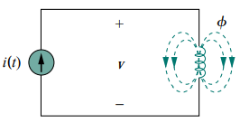
Recap of Self Inductance
1. According to Faraday’s law, the voltage v induced in the coil is proportional to the number of turns N and the time rate of change of the magnetic ﬂux φ.
2. The flux produced by a current is proportional to the current.
(For long straight helix tube, )

Slide 6
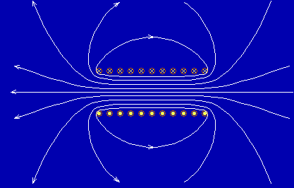
Recap of Self Inductance
3. Self Inductance
4. Self Inductance depends on the permeability μ, the turns N and the size ( l, S ) of the coil.

Slide 7
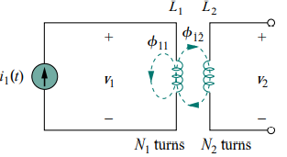
Mutual Inductance
L₁ and L₂ are in close proximity with each other and one of them is open circuited
A current i₁ at L₁ produces B₁,
B₁ links only L₁ ⎯ φ₁₁,
B₁ links both L₁ and L₂ ⎯ φ₁₂
The flux in coil 1⎯
L₂ is open circuited
self inductance
in coil 1
M₂₁⎯mutual inductance of coil 2 with respect to coil 1
Notes:
Asasa

Slide 8
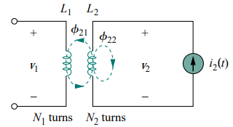
Mutual Inductance
(b) A current i₂ at L₂ produces B₂,
B₂ links only L₂ ⎯ φ₂₂,
B₂ links both L₁ and L₂ ⎯ φ₂₁
The flux in coil 2⎯
L₁ is open circuited
M₁₂⎯ mutual inductance of coil 1 with respect to coil 2
self inductance in coil 2
(c)
Notes:
Asasa

Slide 9
Mutual Inductance
Conclusion:
Mutual inductance is the ability of one inductor to induce a voltage across a neighboring inductor, measured in henrys (H).
(1) The inductors or coils are in close proximity.
(2) The circuits are driven by time-varying sources.
(3) M is always a positive quantity.
(4) The choice of the correct polarity for Mdi/dt is made by examining the orientation or particular way in which both coils are physically wound and applying Lenz’s law in conjunction with the right-hand rule.

Slide 10
Polarity of Mutual Voltage
Combined Mutual and Self-induced Voltage
(No terminal is open circuited)
(a)According to current directions and right-hand rule, we can decide the total flux in each inductor.
(b)According to current and voltage reference, we can decide the sign ‘+’ or ‘-’ in Faraday’s law.

Slide 11
Polarity of Mutual Voltage
Combined Mutual and Self-induced Voltage
•
•

Slide 12
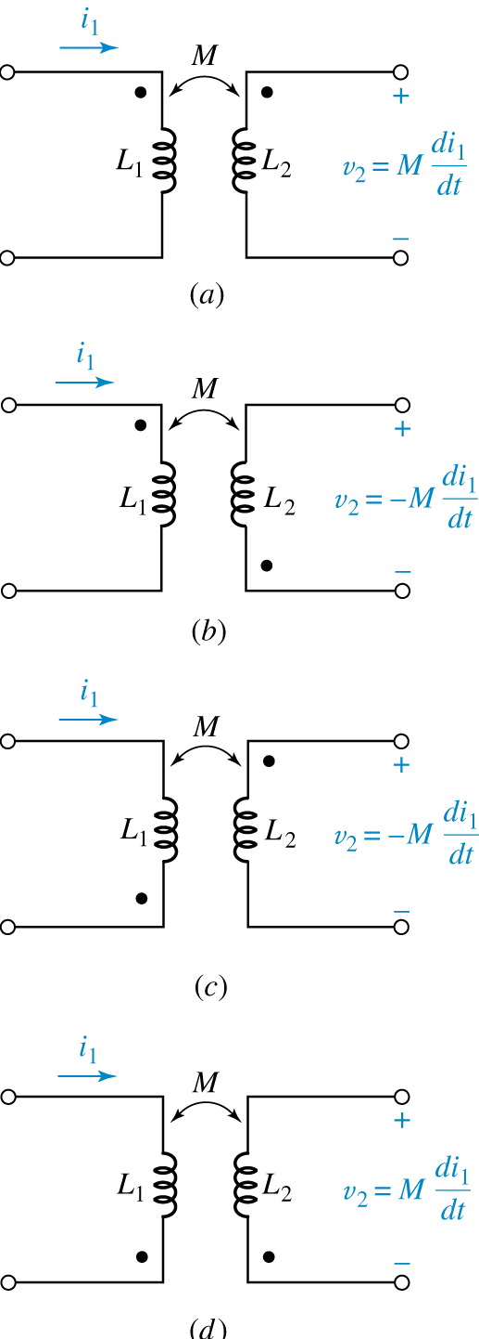
Dot Convention
If a current enters the dotted terminal of one coil, the reference polarity of the mutual voltage in the second coil is positive at the dotted terminal of the second coil.

Slide 13
Dot Convention
Current entering the undotted terminal of one coil produces a voltage that is sensed positively at the undotted terminal of the second coil.

Slide 14
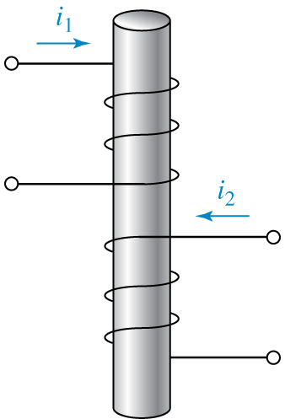
Dot Convention
Physical Basis of Dot Convention
When two currents enter the dotted terminals on each coil, they produce the flux in the same direction.
φ

Slide 15
Dot Convention
Example 13.1
i₂
Find v₁ if i₂=5sin45t A and i₁=0 ;
Find v₂ if i₁= -8e^{-t} A and i₂=0 .
v₁
v₂
(a)
(b)

Slide 16
Dot Convention
Example
Express v₁ and v₂ with i₁ and i₂.

Slide 17
Mutual Inductance in phasor Form

Slide 18
Model of Mutual Inductance in phasor Form
Model of mutual inductance
Fundamental analysis method:
Find the equivalent circuit

Slide 19
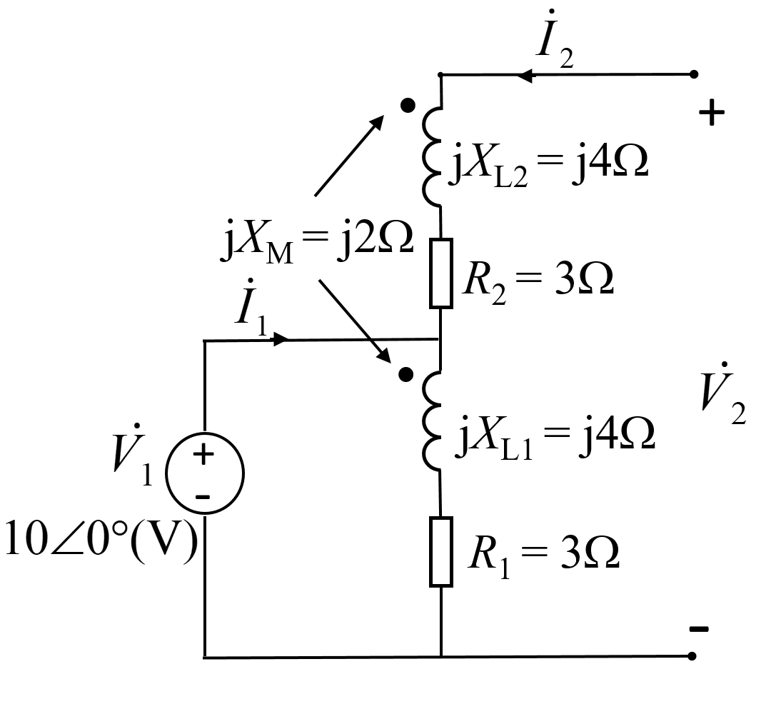
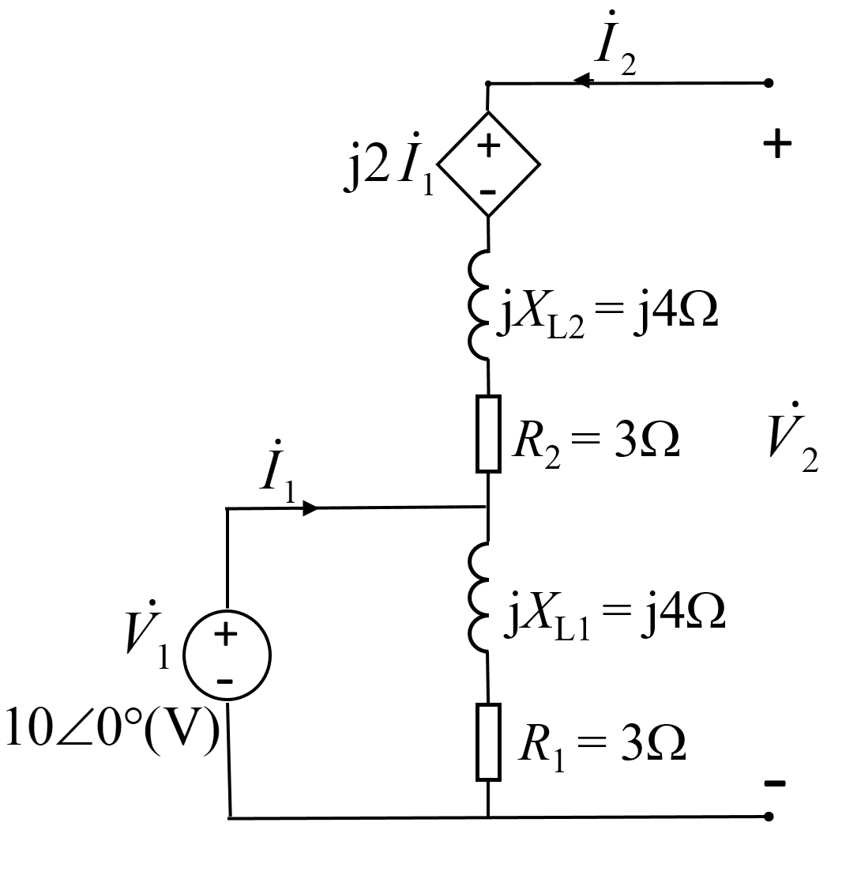
Model of Mutual Inductance in phasor Form
Example
, find
Solution
Notes:
自己没有电流的电感线圈两端也可能有电位差，由互感产生。

Slide 20
Homework
1, 2，3

Slide 21
Connections of coupled inductors
Series connection
Series-aiding connection
Series-opposing connection

Slide 22
Connections of coupled inductors
Parallel connection
Same direction
reverse
Coefficient of Coupling

Slide 23
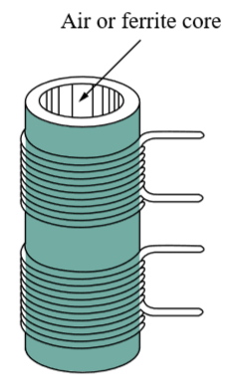
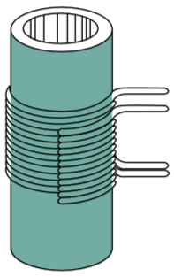
The Coupling Coefficient
The coupling coefficient is a measure of the magnetic coupling between two coils. It depends on the closeness of the two coils, their core, their orientation, and their windings
• k =1 : perfectly coupled
• k > 0.5 : tightly coupled
• k < 0.5 : loosely coupled

Slide 24
Energy Considerations
Demonstration of M₁₂ = M₂₁ by Energy
i₂
Using , calculate the stored energy in coupled inductors at time t when i₁(t)=I₁, i₂(t)=I₂
v₁
v₂
Step1:
0→t₁ : i₁=0→I₁, i₂=0
Step2:
t₁→t : i₁=I₁, i₂=0→I₂

Slide 25
Energy Considerations
i₂
v₁
v₂
If the initial and final conditions are the same, the stored energy must be equal.
Now set step1, 0→t₁ : i₂=0→I₂, i₁=0
step2, t₁→t₂ : i₂=I₂, i₁= 0→ I₁
get

Slide 26
Energy Considerations
For another dot convention case, get
i₂
v₁
v₂
Conclusion
Rewrite in the form:
Since , therefor

Slide 27
Analysis of Circuits with Mutual Inductance
Notes:
Asas

Slide 28
The Linear Transformer
Linear Transformer
Transformer : a four-terminal device with two (or more) magnetically coupled coils.
Primary winding (coil, circuit), secondary winding
Linear transformer :
coils are wound on a magnetically linear material (air, plastic, wood, etc.)
sometimes called air-core transformer.
k<<1
Applications : radio frequency circuits.
Notes:
17 is redundant? With 21 and 25-28

Slide 29
1. Systematic Mesh analysis ⎯ loop analysis method
Example
Find the phasor ratio of .
Solve the equations for I₂

Slide 30
1. Systematic Mesh analysis ⎯ loop analysis method
Example
Calculate the mesh currents .

Slide 31
2. Elimination of Mutual Inductance
Substitute T-shape circuit with a circuit without mutual inductance
Dotted terminals are connected
Dotted terminals are not connected

Slide 32
Ex：
Find i₁ and i₂ by Elimination of Mutual Inductance
R₁=R₂=1Ω, L₁=2H, L₂=1H
Solution
After finding the equivalent circuit, we have mesh equations:
Notes:
练习：用互感消去法,再次计算: 互感次级短路，求初级等效电感>=0，证明Mmax=L1*L2

Slide 33
3. Analysis by Reflected Impedance
Reflected Impedance
Define
Reflected impedance

Slide 34
3. Analysis by Reflected Impedance
Input Impedance
•Primary equivalent circuit:
• Secondary equivalent circuit:

Slide 35
Power on Reflected Impedance
Reflected Resistance and Reflected Reactance
R_{1r}: Reflected Resistance
X_{1r}: Reflected Reactance, → opposite reactance to X₂₂
The power dissipation of secondary equals to that of R_{1r} .

Slide 36
Ex
X_{M} =1Ω,Find I₁,I₂, the source’s supplying power and absorbing power in secondary loop.
(a)
Supply power
(b)
Absorbing power in secondary loop
(c)
or

Slide 37
Ex
X_{M} =1Ω ,Find I₁,I₂ by Thevenin’s theory and absorbing P of 2nd loop.
Notes:
练习：用反映阻抗法,再次计算: 互感次级短路，求初级等效电感>=0，证明Mmax=L1*L2

Slide 38
Example
Calculate the input impedance, I₁ and power of Z_{L},
Given
Solution

Slide 39
Example
Calculate the input impedance, I₁ and power of Z_{L},
Given
Solution

Slide 40
Homework
4, 5，7，9，10

Slide 41
Ideal Transformers
Notes:
Asas

Slide 42
Ideal Transformers
Ideal Transformer
♦ Coils have very large reactance (L₁, L₂, M →∞ )
Coupling coefﬁcient is equal to unity (k = 1).
Primary and secondary coils are lossless (R₁ = 0 = R₂).
Real Transformer
Well-designed iron-core transformer,
tightly coupled, very large reactance of coils,
very small wire resistance.

Slide 43
Ideal transformer and coupled inductance
coils
No loss
coupled inductance
k=1
Perfectly coupled transformer
ideal transformer
i
φ
=
φ
1
11
21
i
2
v
N₁
N₂
v
1
I
II
2
L₁
L₂
φ
=
φ
22
12

Slide 44
Perfectly Coupled transformer (v₁~v₂)
L₁ and L₂ are not infinite, with k=1
∵k=1
Conclusion:

Slide 45
Perfectly Coupled transformer
Turns Ratio
The self-inductance of a coil is proportional to N².
Turns ratio:
n >1 : step-up transformer
n <1 : step-down transformer

Slide 46
Perfectly Coupled transformer (i₁~i₂)
k=1
integral
i
-ni
1
2
i
2
2
1
i_{φ}
i
0
v
L
1
v
1
2
where
1'
1
:
L
/
L
2'
2
1
Ideal transformer

Slide 47
Ideal Transformers
Voltage relationship
1:n
Current relationship
1:n

Slide 48
Ideal Transformers
Lossless Element
1:n
Use rms phasors for sinusoidal steady-state circuit :
1:n
Instantaneous power

Slide 49
Ideal Transformers
Reflected Impedance

Slide 50
Ideal Transformers
Equivalent Circuits
1:n

Slide 51
Ideal Transformers
Equivalent Circuits
1:n

Slide 52
Determine the turn ratio of the matching transformer so that load Z_{L} can draw maximum average power.
Example
1:n
When
Z_{L} gets max power.

Slide 53
Example
Find the power absorbed by 10Ω resistor. 120V is the maximal amplitude of the voltage source.
Mesh equation:
Substitute into mesh equations,

Slide 54
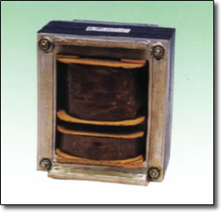
Autotransformer
Example
Find the input impedance Z_{i} .
Given
Solution
For autotransformer, k=1

Slide 55
Example
Find
Solution
(1) Find k
R_{L}
(2) Draw the equivalent circuit with ideal transformer
(3)Draw the primary equivalent circuit

Slide 56
Alternative method：Reflected Impedance
R_{L}

Slide 57
Example
Find Z_{L}=？ P_{Lmax}
P_{Lmax}=?
Vrms
Solution
Find Thevinin equivalence

Slide 59
Real transformer
If loss is not 0, there is R.
If it works at high frequency, there is C.

Slide 60
Homework
5.12, 5.13, 5.17, 5.19
Notes:
P543, 13.6

